Slide 1
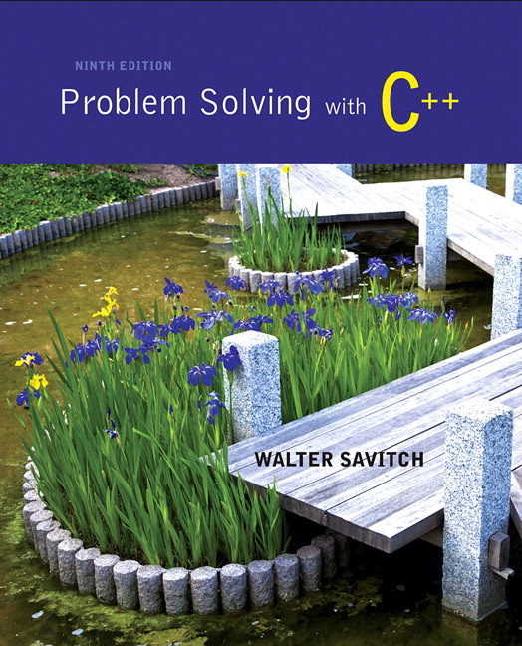
Problem Solving with C++ by Walter Savitch

Slide 2
Chapter 4
Procedural Abstraction and Functions That Return a Value

Slide 3
Overview
4.1 Top-Down Design
4.2 Predefined Functions
4.3 Programmer-Defined Functions
4.4 Procedural Abstraction
4.5 Local Variables
4.6 Overloading Function Names

Slide 4
4.1
Top-Down Design

Slide 5
Top Down Design
To write a program
Develop the algorithm that the program will use
Translate the algorithm into the programming language
Top Down Design (also called stepwise refinement)
Break the algorithm into subtasks
Break each subtask into smaller subtasks
Eventually the smaller subtasks are trivial to implement in the programming language

Slide 6
Benefits of Top Down Design
Subtasks, or functions in C++, make programs
Easier to understand
Easier to change
Easier to write
Easier to test
Easier to debug
Easier for teams to develop

Slide 7
4.2
Predefined Functions

Slide 8
Predefined Functions
C++ comes with libraries of predefined functions
Example: sqrt function
the_root = sqrt(9.0);
returns, or computes, the square root of a number
The number, 9, is called the argument
the_root will contain 3.0

Slide 9
Function Calls
sqrt(9.0) is a function call
It invokes, or sets in action, the sqrt function
The argument (9), can also be a variable or an expression
A function call can be used like any expression
bonus = sqrt(sales) / 10;
Cout << “The side of a square with area “ << area << “ is “ << sqrt(area);
Display 4.1

Slide 10
Function Call Syntax
Function_name (Argument_List)
Argument_List is a comma separated list: (Argument_1, Argument_2, … , Argument_Last)
Example:
side = sqrt(area);
cout << “2.5 to the power 3.0 is “ << pow(2.5, 3.0);

Slide 11
Function Libraries
Predefined functions are found in libraries
The library must be “included” in a program to make the functions available
An include directive tells the compiler which library header file to include.
To include the math library containing sqrt(): #include <cmath>
Newer standard libraries, such as cmath, also require the directive using namespace std;

Slide 12
Other Predefined Functions
abs(x) --- int value = abs(-8);
Returns absolute value of argument x
Return value is of type int
Argument is of type x
Found in the library cstdlib
fabs(x) --- double value = fabs(-8.0);
Returns the absolute value of argument x
Return value is of type double
Argument is of type double
Found in the library cmath
Display 4.2

Slide 13
Random Number Generation
Really pseudo-random numbers
1. Seed the random number generator only once
#include <cstdlib>
#include <ctime>
srand(time(0));
2. The rand() function returns a random integer that is greater than or equal to 0 and less than RAND_MAX
rand();

Slide 14
Random Numbers
Use % and + to scale to the number range you want
For example to get a random number from 1-6 to simulate rolling a six-sided die:
int die = (rand() % 6) + 1;
Can you simulate rolling two dice?
Generating a random number x where 10 < x < 21?

Slide 15
Type Casting
Recall the problem with integer division: int total_candy = 9, number_of_people = 4; double candy_per_person; candy_per_person = total_candy / number_of_people;
candy_per_person = 2, not 2.25!
A Type Cast produces a value of one type from another type
static_cast<double>(total_candy) produces a double representing the integer value of total_candy

Slide 16
Type Cast Example
int total_candy = 9, number_of_people = 4; double candy_per_person; candy_per_person = static_cast<double>(total_candy) / number_of_people;
candy_per_person now is 2.25!
This would also work: candy_per_person = total_candy / static_cast<double>( number_of_people);
This would not! candy_per_person = static_cast<double>( total_candy / number_of_people);
Integer division occurs before type cast

Slide 17
Old Style Type Cast
C++ is an evolving language
This older method of type casting may be discontinued in future versions of C++ candy_per_person = double(total_candy)/number_of_people;
candy_per_person = (double) total_candy /number_of_people;

Slide 18
Section 4.2 Conclusion
Can you
Determine the value of d? double d = 11 / 2;
Determine the value of pow(2,3) fabs(-3.5) sqrt(pow(3,2)) 7 / abs(-2) ceil(5.8) floor(5.8)
Convert the following to C++

Slide 19
4.3
Programmer-Defined Functions

Slide 20
Programmer-Defined Functions
Two components of a function definition
Function declaration (or function prototype)
Shows how the function is called
Must appear in the code before the function can be called
Syntax: Type_returned Function_Name(Parameter_List); //Comment describing what function does
Function definition
Describes how the function does its task
Can appear before or after the function is called
Syntax: Type_returned Function_Name(Parameter_List) { //code to make the function work }
;

Slide 21
Function Declaration
Tells the return type
Tells the name of the function
Tells how many arguments are needed
Tells the types of the arguments
Tells the formal parameter names
Formal parameters are like placeholders for the actual arguments used when the function is called
Formal parameter names can be any valid identifier
Example: double total_cost(int number_par, double price_par); // Compute total cost including 5% sales tax on // number_par items at cost of price_par each

Slide 22
Function Definition
Provides the same information as the declaration
Describes how the function does its task
Example: double total_cost(int number_par, double price_par) { const double TAX_RATE = 0.05; //5% tax double subtotal; subtotal = price_par * number_par; return (subtotal + subtotal * TAX_RATE); }
function header
function body

Slide 23
The Return Statement
Ends the function call
Returns the value calculated by the function
Syntax: return expression;
expression performs the calculation or
expression is a variable containing the calculated value
Example: return subtotal + subtotal * TAX_RATE;

Slide 24
The Function Call
Tells the name of the function to use
Lists the arguments
Is used in a statement where the returned value makes sense
Example: double bill = total_cost(number, price);
Display 4.3

Slide 25
Function Call Details
The values of the arguments are plugged into the formal parameters (Call-by-value mechanism with call-by-value parameters)
The first argument is used for the first formal parameter, the second argument for the second formal parameter, and so forth.
The value plugged into the formal parameter is used in all instances of the formal parameter in the function body
Display 4.4

Slide 26
Alternate Declarations
Two forms for function declarations
List formal parameter names
List types of formal parmeters, but not names
First aids description of the function in comments
Examples: double total_cost(int number_par, double price_par); double total_cost(int, double);
Function headers must always list formal parameter names!

Slide 27
Order of Arguments
Compiler checks that the types of the arguments are correct and in the correct sequence.
Compiler cannot check that arguments are in the correct logical order
Example: Given the function declaration: char grade(int received_par, int min_score_par); int received = 95, min_score = 60; cout << grade( min_score, received);
Produces a faulty result because the arguments are not in the correct logical order. The compiler will not catch this!
Display 4.5 (1)
Display 4.5 (2)

Slide 28
Function Definition Syntax
Within a function definition
Variables must be declared before they are used
Variables are typically declared before the executable statements begin
At least one return statement must end the function
Each branch of an if-else statement might have its own return statement
Display 4.6

Slide 29
Placing Definitions
A function call must be preceded by either
The function’s declaration or
The function’s definition
If the function’s definition precedes the call, a declaration is not needed
Placing the function declaration prior to the main function and the function definition after the main function leads naturally to building your own libraries in the future.

Slide 30
bool Return Values
A function can return a bool value
Such a function can be used where a boolean expression is expected
Makes programs easier to read
if (((rate >=10) && ( rate < 20)) || (rate == 0)) is easier to read as if (appropriate (rate))
If function appropriate returns a bool value based on the the expression above

Slide 31
Function appropriate
To use function appropriate in the if-statement if (appropriate (rate)) { … } appropriate could be defined as bool appropriate(int rate) { return (((rate >=10) && ( rate < 20)) || (rate == 0)); }

Slide 32
Section 4.3 Conclusion
Can you
Write a function declaration and a function definition for a function that takes three arguments, all of type int, and that returns the sum of its three arguments?
Describe the call-by-value parameter mechanism?
Write a function declaration and a function definition for a function that takes one argument of type int and one argument of type double, and that returns a value of type double that is the average of the two arguments?

Slide 33
4.4
Procedural Abstraction

Slide 34
Procedural Abstraction
The Black Box Analogy
A black box refers to something that we know how to use, but the method of operation is unknown
A person using a program does not need to know how it is coded
A person using a program needs to know what the program does, not how it does it
Functions and the Black Box Analogy
A programmer who uses a function needs to know what the function does, not how it does it
A programmer needs to know what will be produced if the proper arguments are put into the box

Slide 35
Information Hiding
Designing functions as black boxes is an example of information hiding
The function can be used without knowing how it is coded
The function body can be “hidden from view”

Slide 36
Function Implementations and The Black Box
Designing with the black box in mind allows us
To change or improve a function definition without forcing programmers using the function to change what they have done
To know how to use a function simply by reading the function declaration and its comment
Display 4.7

Slide 37
Procedural Abstraction and C++
Procedural Abstraction is writing and using functions as if they were black boxes
Procedure is a general term meaning a “function like” set of instructions
Abstraction implies that when you use a function as a black box, you abstract away the details of the code in the function body

Slide 38
Procedural Abstraction and Functions
Write functions so the declaration and comment is all a programmer needs to use the function
Function comment should tell all conditions required of arguments to the function
Function comment should describe the returned value
Variables used in the function, other than the formal parameters, should be declared in the function body

Slide 39
Formal Parameter Names
Functions are designed as self-contained modules
Different programmers may write each function
Programmers choose meaningful names for formal parameters
Formal parameter names may or may not match variable names used in the main part of the program
It does not matter if formal parameter names match other variable names in the program
Remember that only the value of the argument is plugged into the formal parameter
Display 4.8

Slide 40
Case Study Buying Pizza
What size pizza is the best buy?
Which size gives the lowest cost per square inch?
Pizza sizes given in diameter
Quantity of pizza is based on the area which is proportional to the square of the radius

Slide 41
Buying Pizza Problem Definition
Input:
Diameter of two sizes of pizza
Cost of the same two sizes of pizza
Output:
Cost per square inch for each size of pizza
Which size is the best buy
Based on lowest price per square inch
If cost per square inch is the same, the smaller size will be the better buy

Slide 42
Buying Pizza Problem Analysis
Subtask 1
Get the input data for each size of pizza
Subtask 2
Compute price per inch for smaller pizza
Subtask 3
Compute price per inch for larger pizza
Subtask 4
Determine which size is the better buy
Subtask 5
Output the results

Slide 43
Buying Pizza Function Analysis
Subtask 2 and subtask 3 should be implemented as a single function because
Subtask 2 and subtask 3 are identical tasks
The calculation for subtask 3 is the same as the calculation for subtask 2 with different arguments
Subtask 2 and subtask 3 each return a single value
Choose an appropriate name for the function
We’ll use unitprice

Slide 44
Buying Pizza unitprice Declaration
double unitprice(int diameter, int double price); //Returns the price per square inch of a pizza //The formal parameter named diameter is the //diameter of the pizza in inches. The formal // parameter named price is the price of the // pizza.

Slide 45
Buying Pizza Algorithm Design
Subtask 1
Ask for the input values and store them in variables
diameter_small diameter_large price_small price_large
Subtask 4
Compare cost per square inch of the two pizzas using the less than operator
Subtask 5
Standard output of the results

Slide 46
Buying Pizza unitprice Algorithm
Subtasks 2 and 3 are implemented as calls to function unitprice
unitprice algorithm
Compute the radius of the pizza
Computer the area of the pizza using
Return the value of (price / area)

Slide 47
Buying Pizza unitprice Pseudocode
Pseudocode
Mixture of C++ and english
Allows us to make the algorithm more precise without worrying about the details of C++ syntax
unitprice pseudocode
radius = one half of diameter; area = π * radius * radius return (price / area)

Slide 48
Buying Pizza The Calls of unitprice
Main part of the program implements calls of unitprice as
double unit_price_small, unit_price_large; unit_price_small = unitprice(diameter_small, price_small); unit_price_large = unitprice(diameter_large, price_large);

Slide 49
Buying Pizza First try at unitprice
double unitprice (int diameter, double price) { const double PI = 3.14159; double radius, area; radius = diameter / 2; area = PI * radius * radius; return (price / area); }
Oops! Radius should include the fractional part

Slide 50
Buying Pizza Second try at unitprice
double unitprice (int diameter, double price) { const double PI = 3.14159; double radius, area; radius = diameter / static_cast<double>(2) ; area = PI * radius * radius; return (price / area); }
Now radius will include fractional parts
radius = diameter / 2.0 ; // This would also work
Display 4.10 (1)
Display 4.10 (2)

Slide 51
Program Testing
Programs that compile and run can still produce errors
Testing increases confidence that the program works correctly
Run the program with data that has known output
You may have determined this output with pencil and paper or a calculator
Run the program on several different sets of data
Your first set of data may produce correct results in spite of a logical error in the code
Remember the integer division problem? If there is no fractional remainder, integer division will give apparently correct results

Slide 52
Use Pseudocode
Pseudocode is a mixture of English and the programming language in use
Pseudocode simplifies algorithm design by allowing you to ignore the specific syntax of the programming language as you work out the details of the algorithm
If the step is obvious, use C++
If the step is difficult to express in C++, use English

Slide 53
Section 4.4 Conclusion
Can you
Describe the purpose of the comment that accompanies a function declaration?
Describe what it means to say a programmer should be able to treat a function as a black box?
Describe what it means for two functions to be black box equivalent?

Slide 54
4.5
Local Variables

Slide 55
Local Variables
Variables declared in a function:
Are local to that function, they cannot be used from outside the function
Have the function as their scope
Variables declared in the main part of a program:
Are local to the main part of the program, they cannot be used from outside the main part
Have the main part as their scope
Display 4.11 (1)
Display 4.11 (2)

Slide 56
Global Constants
Global Named Constant
Available to more than one function as well as the main part of the program
Declared outside any function body
Declared outside the main function body
Declared before any function that uses it
Example: const double PI = 3.14159; double volume(double); int main() {…}
PI is available to the main function and to function volume
Display 4.12 (1)
Display 4.12 (2)

Slide 57
Global Variables
Global Variable -- rarely used when more than one function must use a common variable
Declared just like a global constant except const is not used
Generally make programs more difficult to understand and maintain

Slide 58
Formal Parameters are Local Variables
Formal Parameters are actually variables that are local to the function definition
They are used just as if they were declared in the function body
Do NOT re-declare the formal parameters in the function body, they are declared in the function declaration
The call-by-value mechanism
When a function is called the formal parameters are initialized to the values of the arguments in the function call
Display 4.13 (1)
Display 4.13 (2)

Slide 59
Block Scope
Local and global variables conform to the rules of Block Scope
The code block (generally defined by the { }) where an identifier like a variable is declared determines the scope of the identifier
Blocks can be nested
Display 4.14

Slide 60
Namespaces Revisited
The start of a file is not always the best place for using namespace std;
Different functions may use different namespaces
Placing using namespace std; inside the starting brace of a function
Allows the use of different namespaces in different functions
Makes the “using” directive local to the function
Display 4.15 (1)
Display 4.15 (2)

Slide 61
Example: Factorial
n! Represents the factorial function
n! = 1 x 2 x 3 x … x n
The C++ version of the factorial function found in Display 3.14
Requires one argument of type int, n
Returns a value of type int
Uses a local variable to store the current product
Decrements n each time it does another multiplication n * n-1 * n-2 * … * 1
Display 4.16

Slide 62
4.6
Overloading Function Names

Slide 63
Overloading Function Names
C++ allows more than one definition for the same function name
Very convenient for situations in which the “same” function is needed for different numbers or types of arguments
Overloading a function name means providing more than one declaration and definition using the same function name

Slide 64
Overloading Examples
double ave(double n1, double n2) { return ((n1 + n2) / 2); }
double ave(double n1, double n2, double n3) { return (( n1 + n2 + n3) / 3); }
Compiler checks the number and types of arguments in the function call to decide which function to use cout << ave( 10, 20, 30); uses the second definition

Slide 65
Overloading Details
Overloaded functions
Must have different numbers of formal parameters AND / OR
Must have at least one different type of parameter
Must return a value of the same type
Display 4.17

Slide 66
Overloading Example
Revising the Pizza Buying program
Rectangular pizzas are now offered!
Change the input and add a function to compute the unit price of a rectangular pizza
The new function could be named unitprice_rectangular
Or, the new function could be a new (overloaded) version of the unitprice function that is already used
Example: double unitprice(int length, int width, double price) { double area = length * width; return (price / area); }
Display 4.18 (1 – 3)

Slide 67
Automatic Type Conversion
Given the definition double mpg(double miles, double gallons) { return (miles / gallons); } what will happen if mpg is called in this way? cout << mpg(45, 2) << “ miles per gallon”;
The values of the arguments will automatically be converted to type double (45.0 and 2.0)

Slide 68
Type Conversion Problem
Given the previous mpg definition and the following definition in the same program int mpg(int goals, int misses) // returns the Measure of Perfect Goals { return (goals – misses); } what happens if mpg is called this way now? cout << mpg(45, 2) << “ miles per gallon”;
The compiler chooses the function that matches parameter types so the Measure of Perfect Goals will be calculated
Do not use the same function name for unrelated functions

Slide 69
Section 4.6 Conclusion
Can you
Describe Top-Down Design?
Describe the types of tasks we have seen so far that could be implemented as C++ functions?
Describe the principles of
The black box
Procedural abstraction
Information hiding
Define “local variable”?
Overload a function name?

Slide 70
Chapter 4 -- End

Slide 71
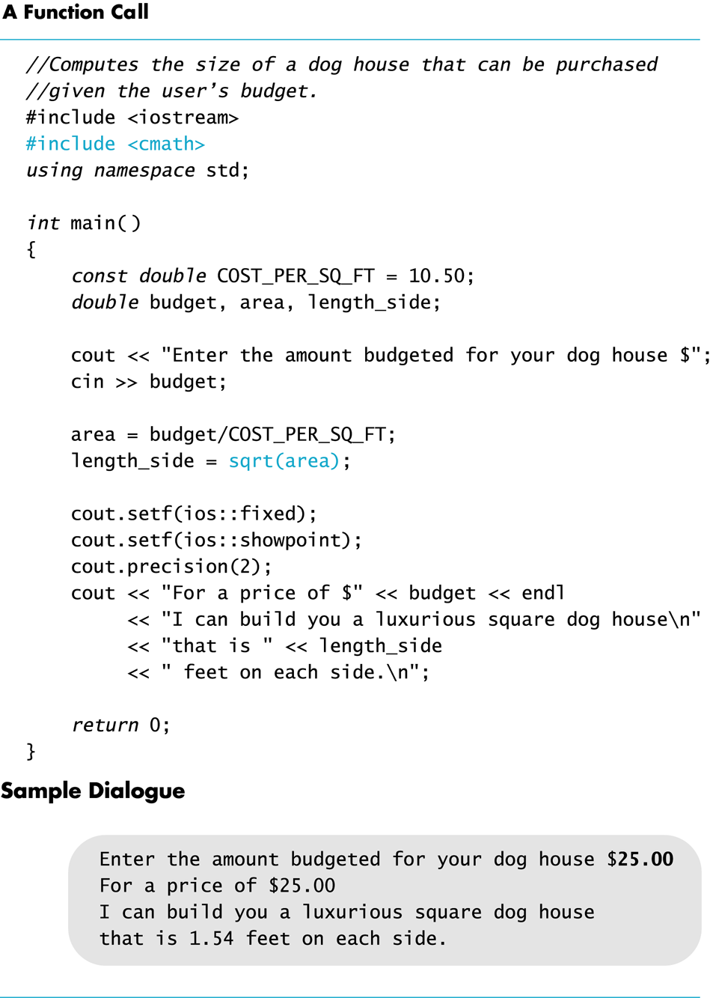
Display 4.1
Back
Next

Slide 72
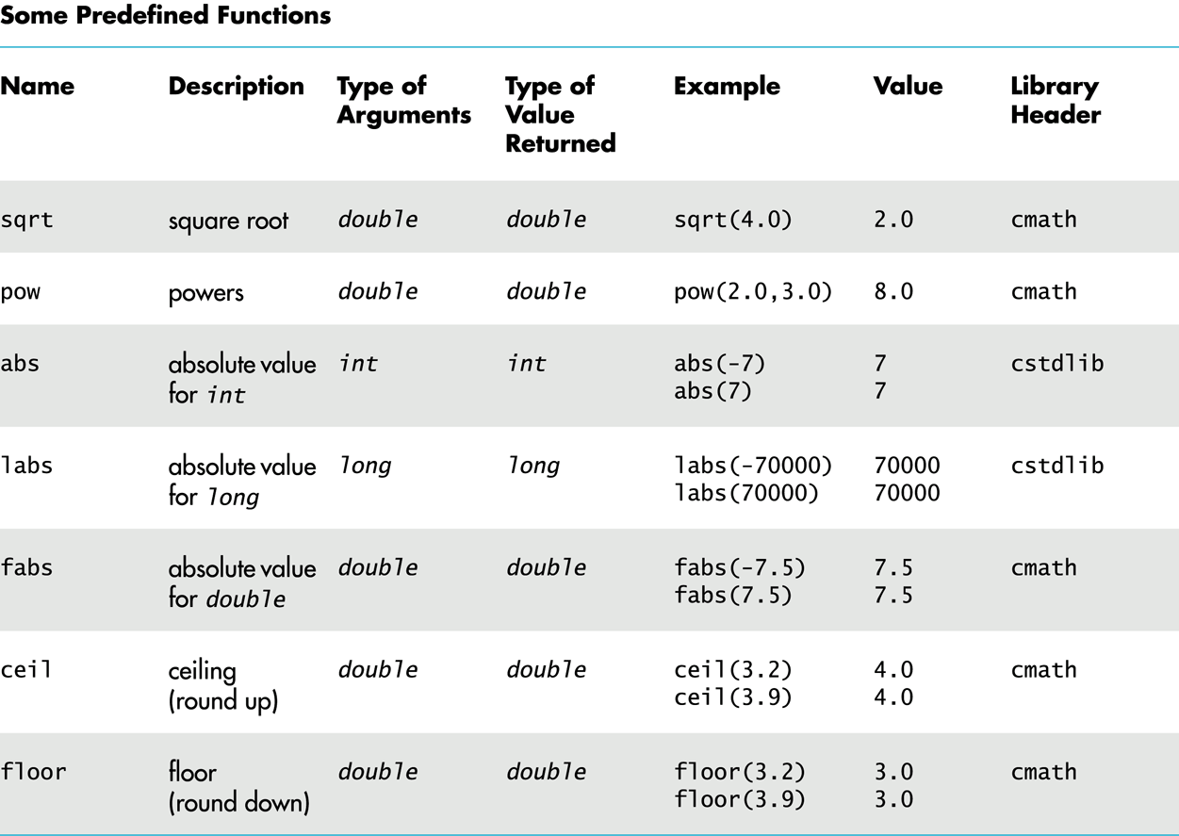
Display 4.2
Back
Next

Slide 73
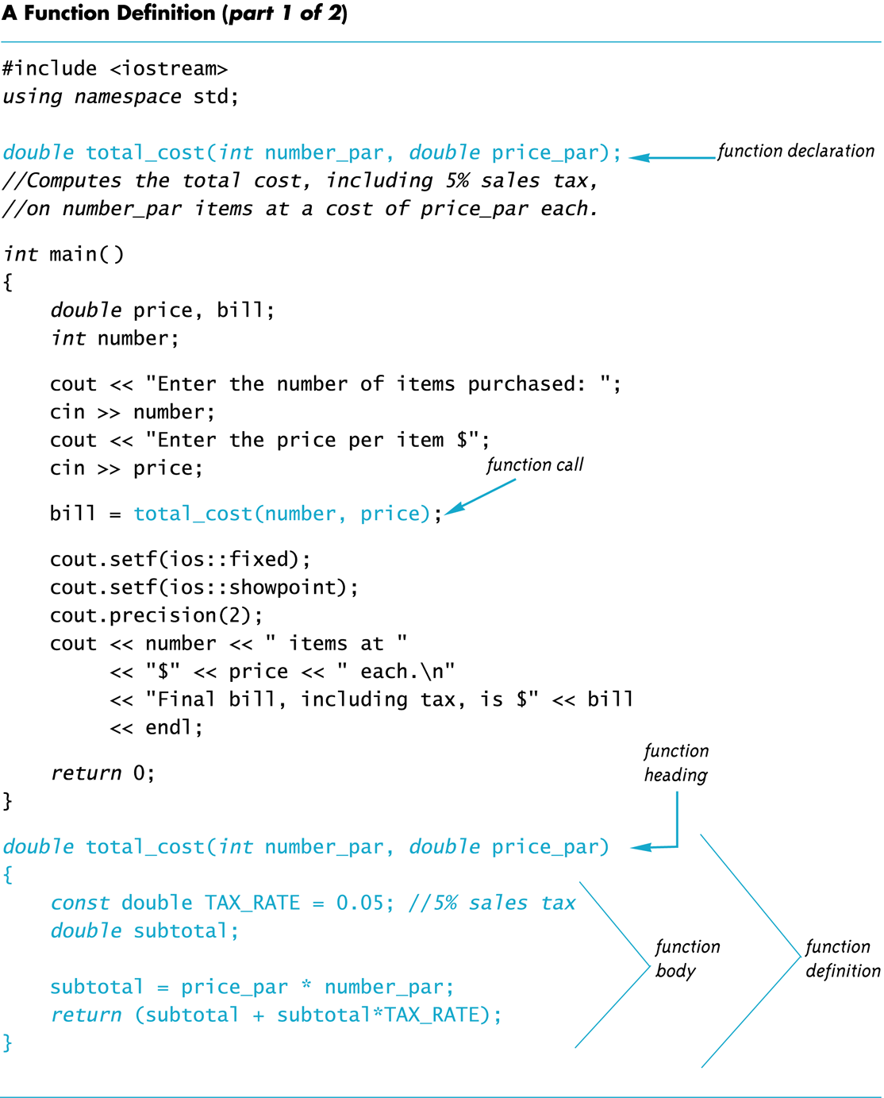
Display 4.3 (1/2)
Back
Next

Slide 74
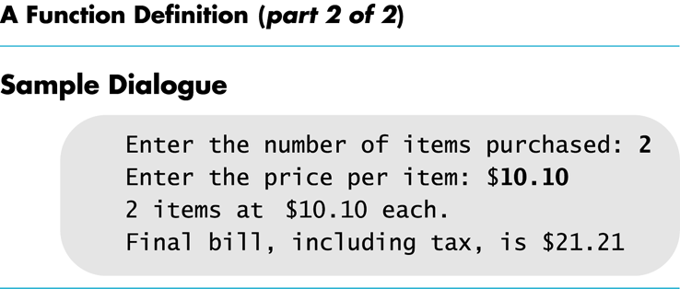
Display 4.3 (2/2)
Back
Next

Slide 75
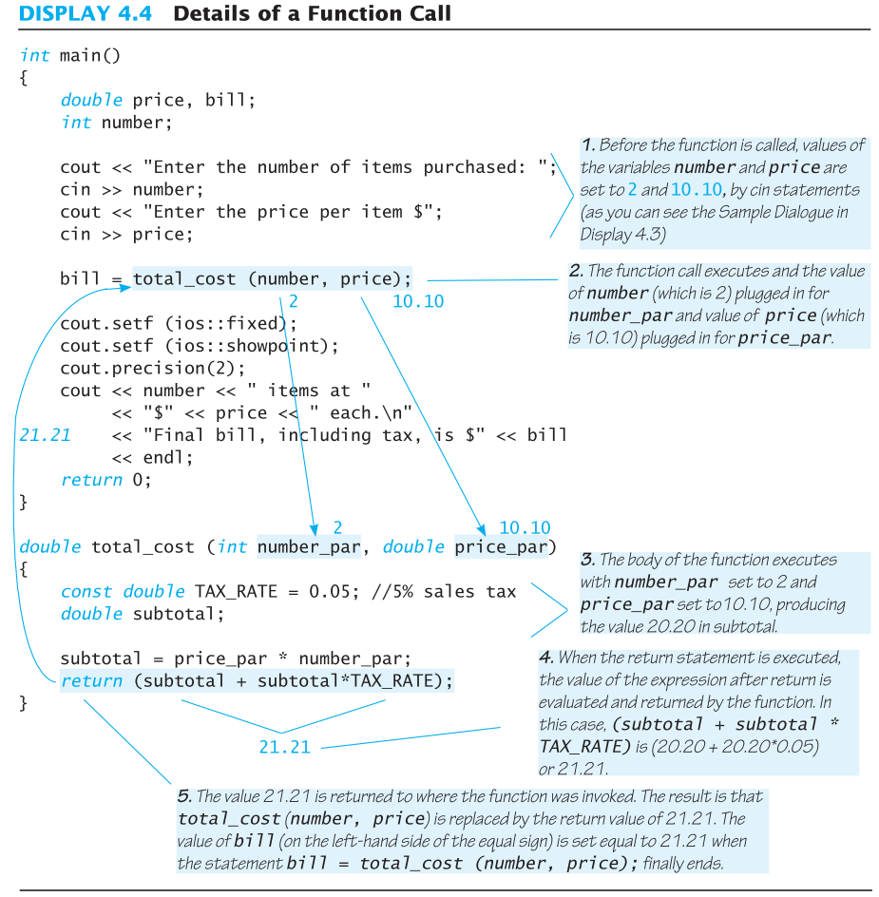
Display 4.4
Back
Next

Slide 76
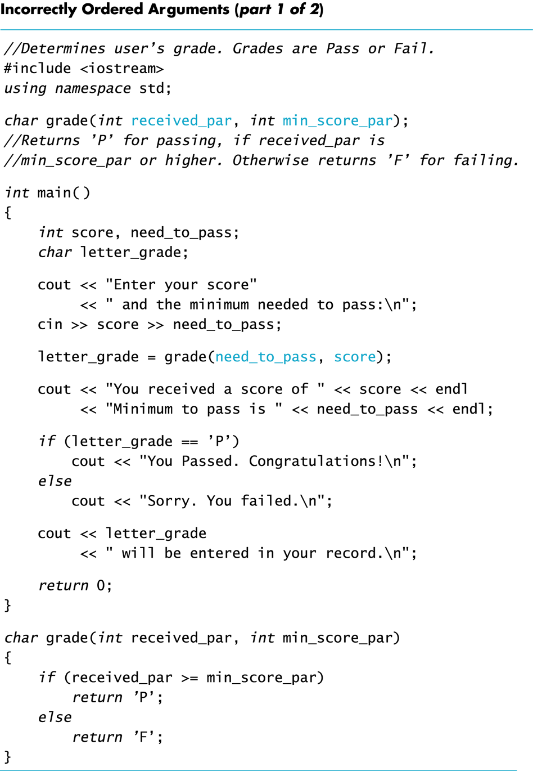
Display 4.5 (1/2)
Back
Next

Slide 77
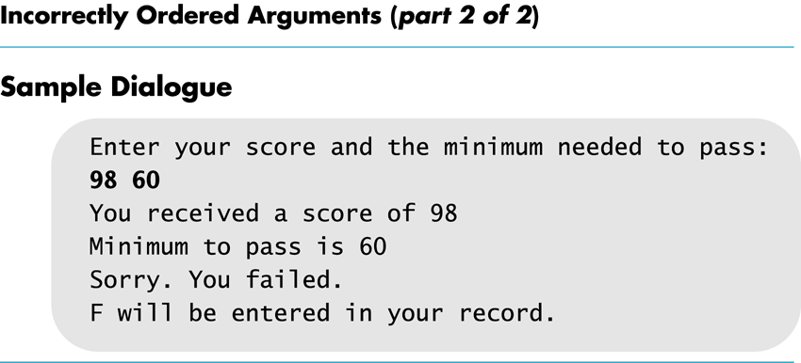
Display 4.5 (2/2)
Back
Next

Slide 78
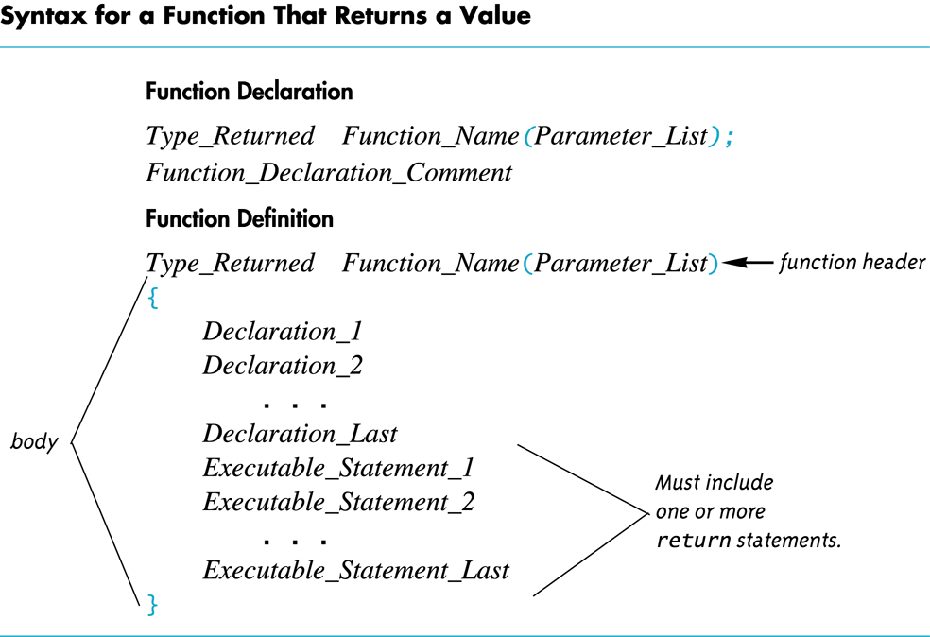
Display 4.6
Back
Next

Slide 79
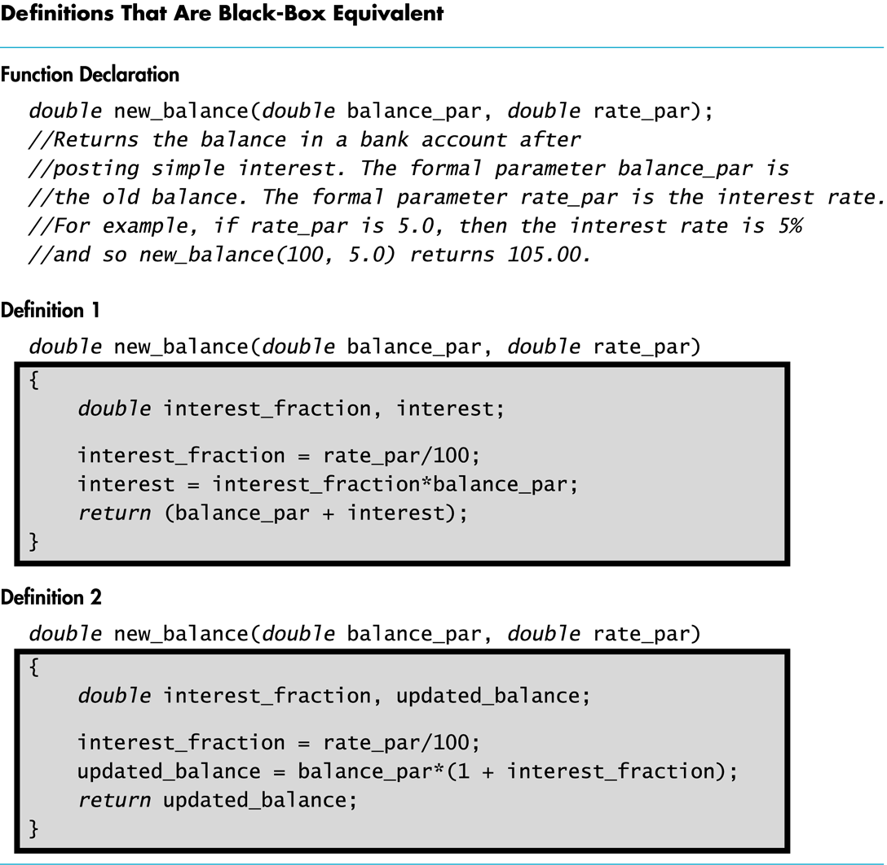
Display 4.7
Back
Next

Slide 80
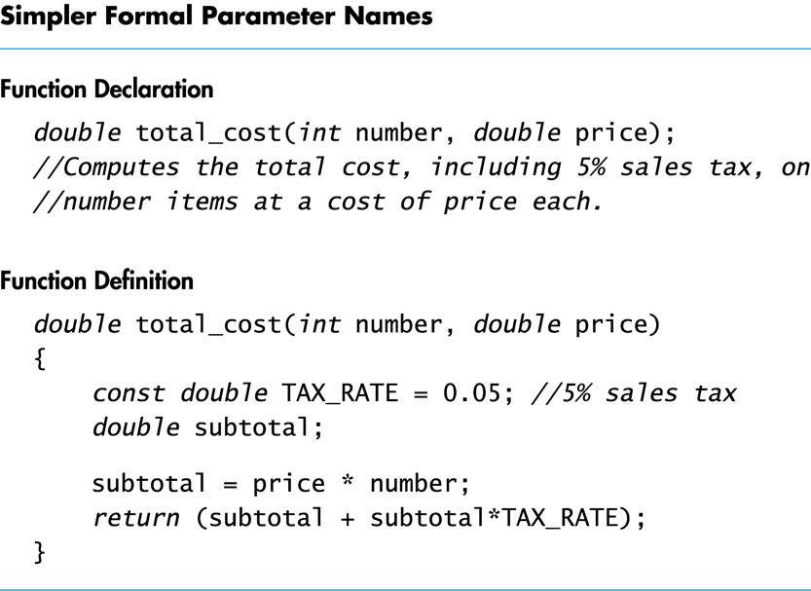
Display 4.8
Back
Next

Slide 81
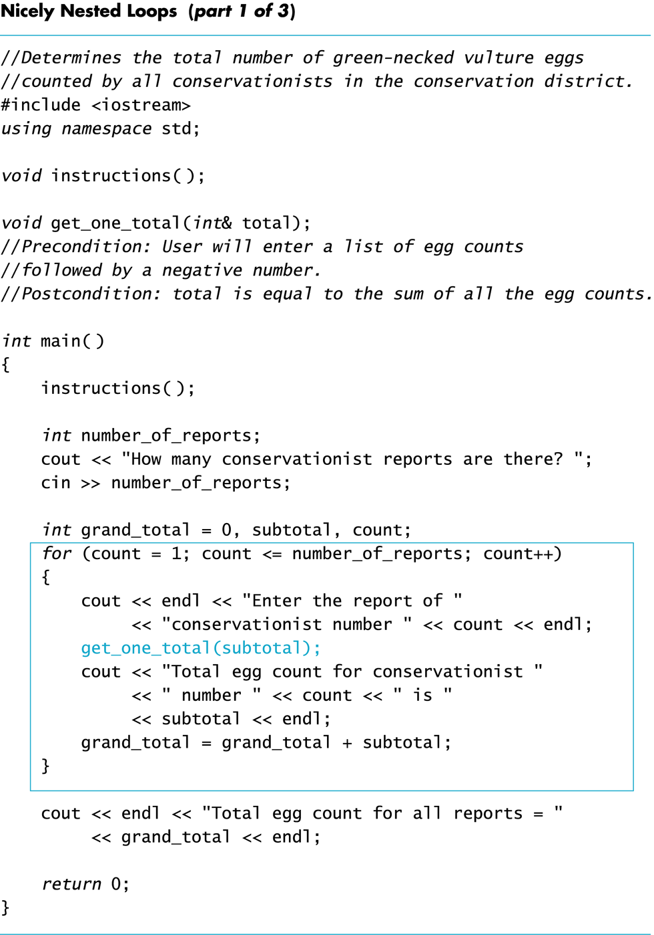
Display 4.9 (1/3)
Back
Next

Slide 82
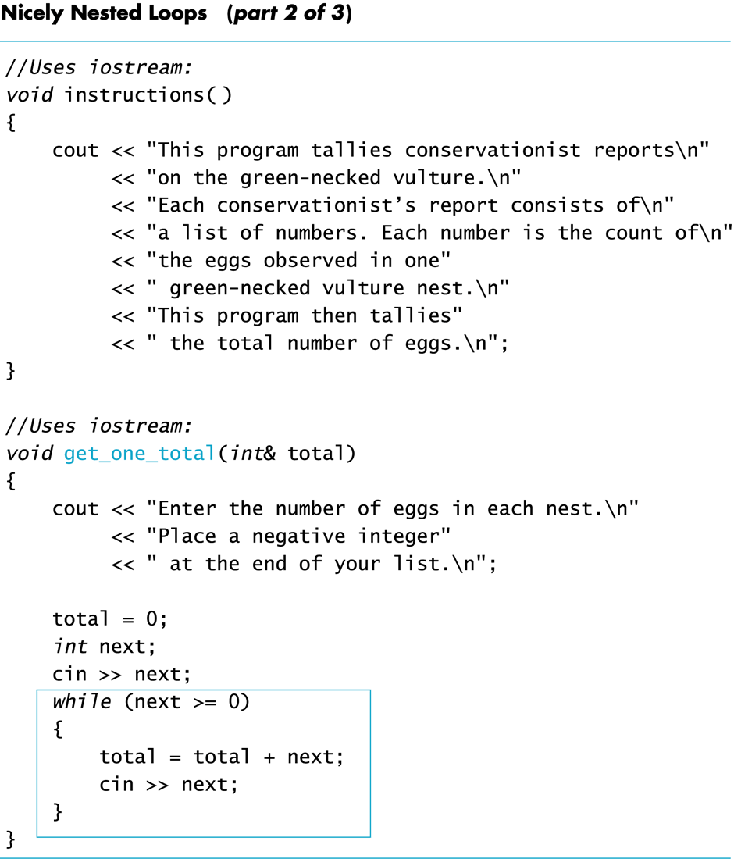
Display 4.9 (2/3)
Back
Next

Slide 83
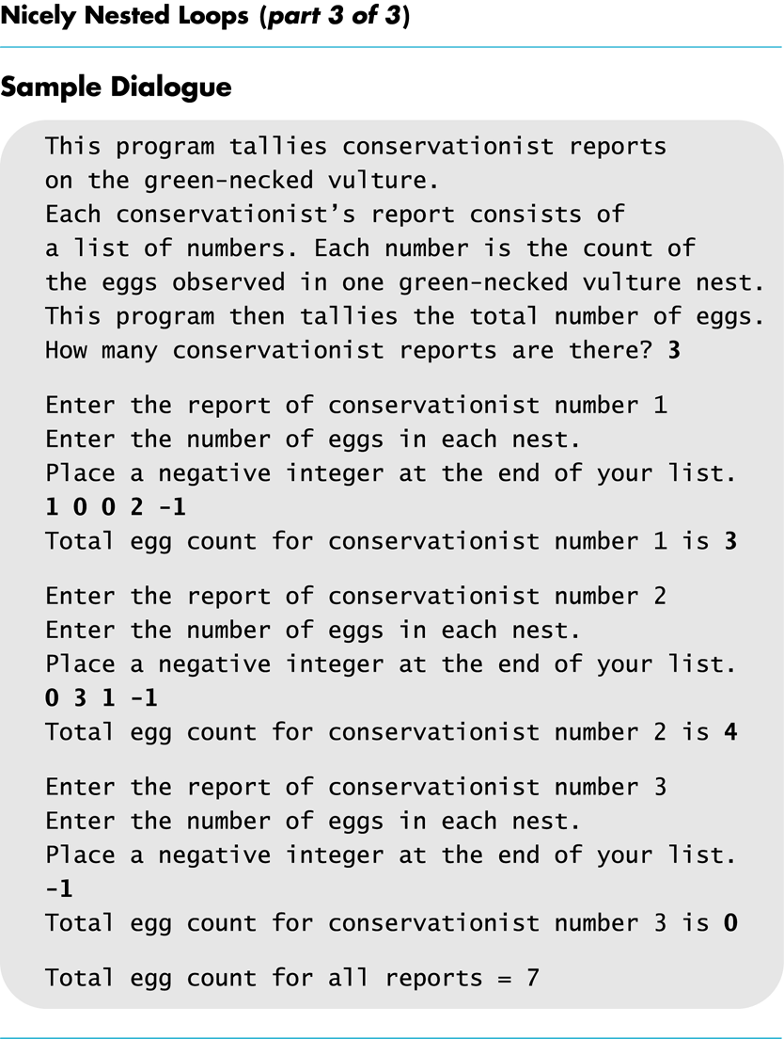
Display 4.9 (3/3)
Back
Next

Slide 84
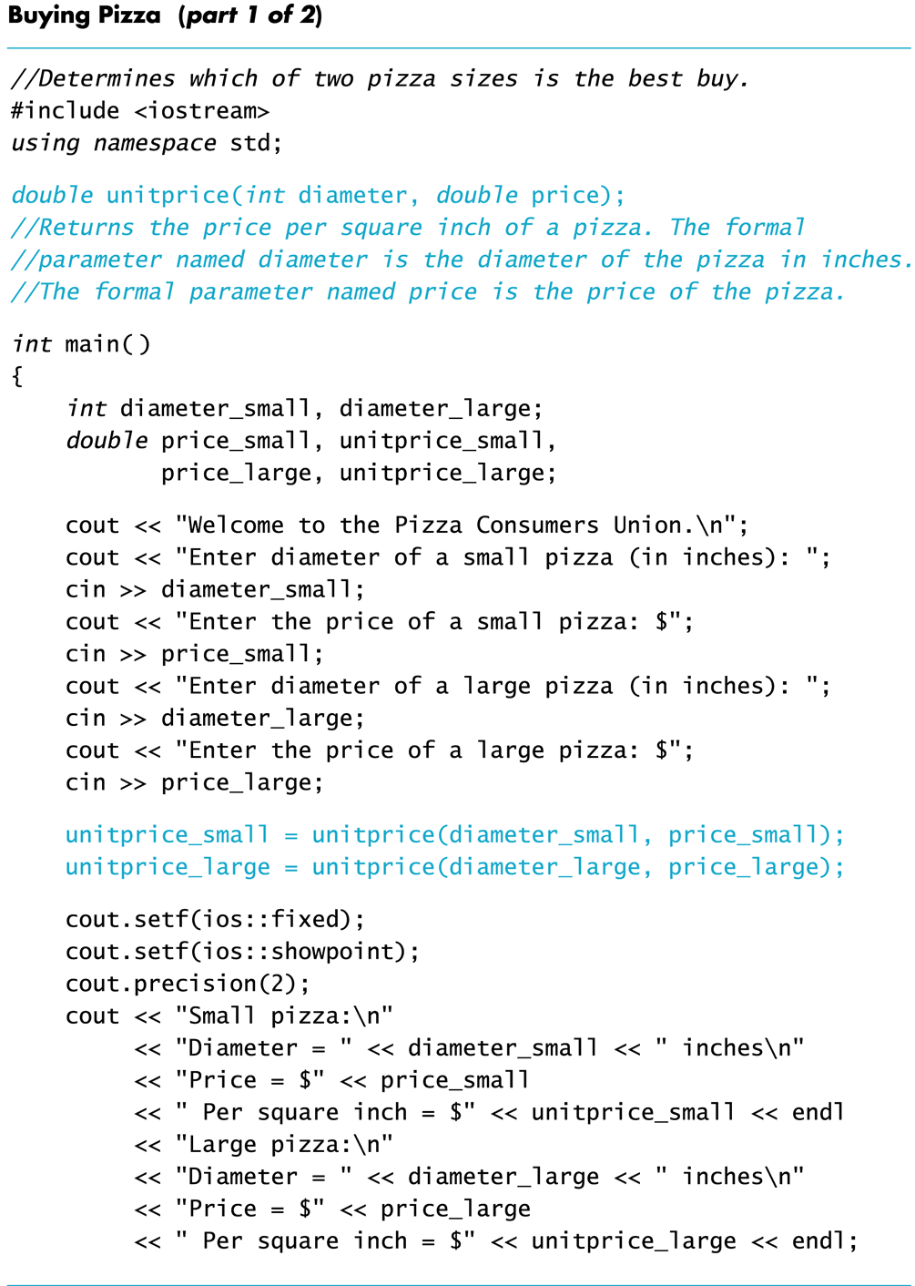
Display 4.10 (1/2)
Back
Next

Slide 85
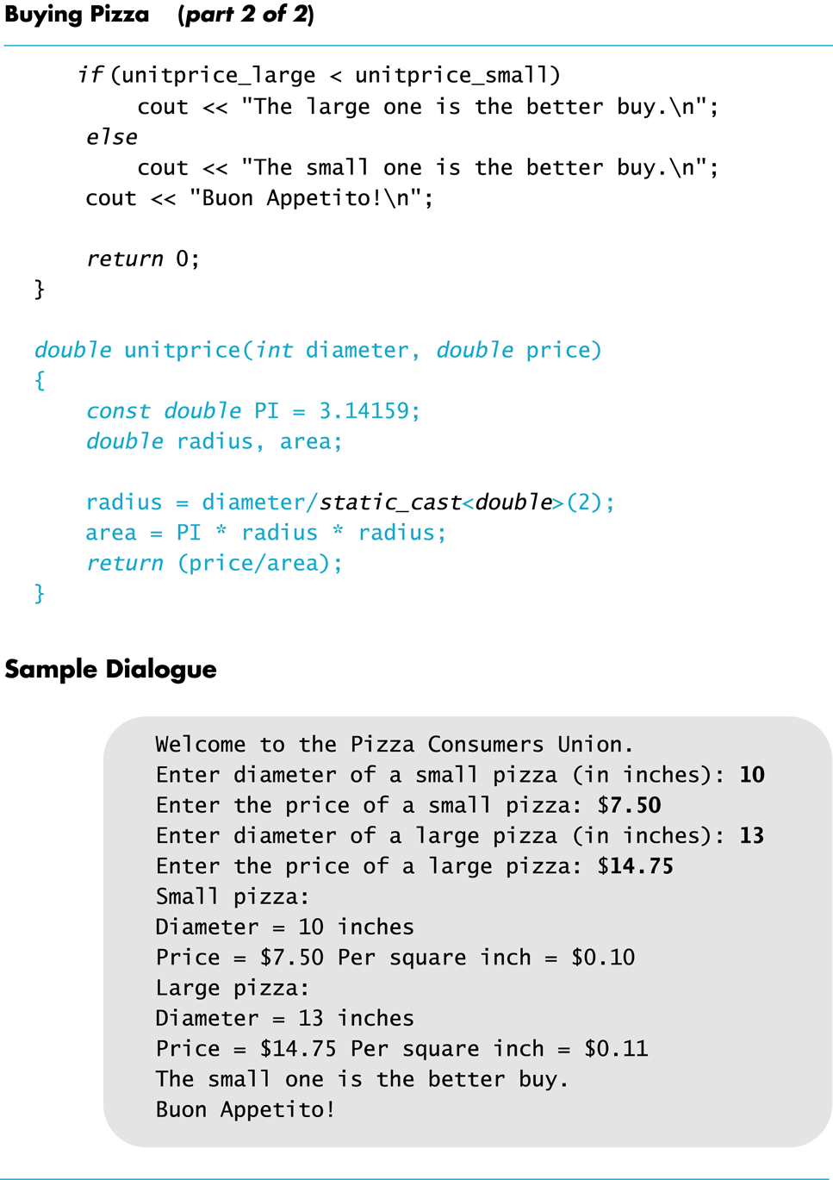
Display 4.10 (2/2)
Back
Next

Slide 86
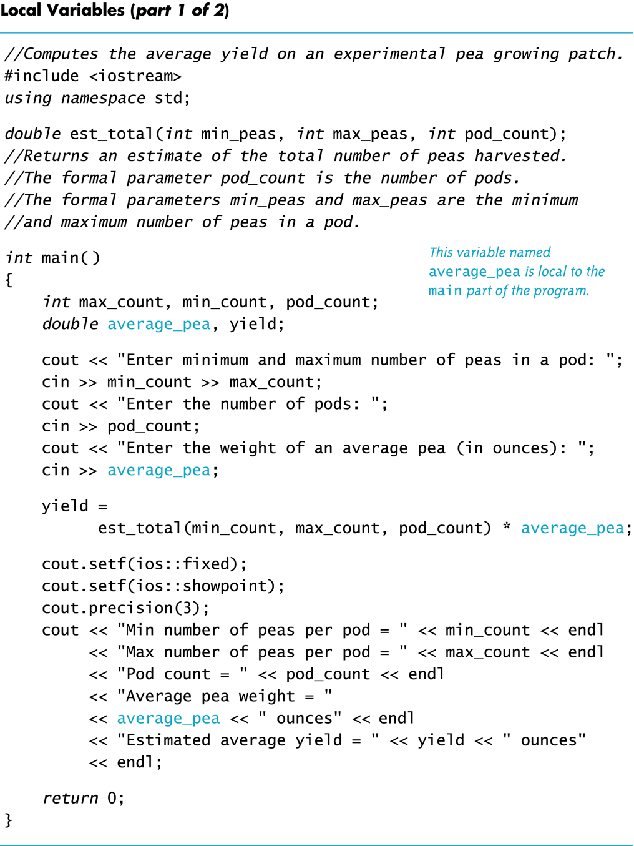
Display 4.11 (1/2)
Back
Next

Slide 87
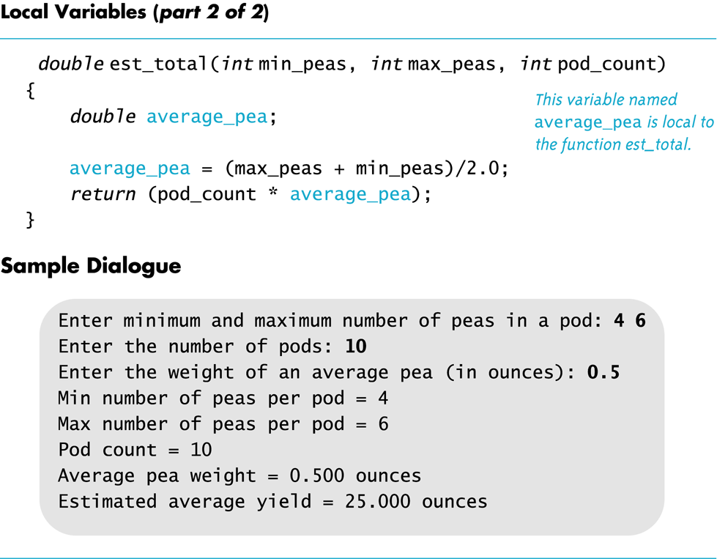
Display 4.11 (2/2)
Back
Next

Slide 88
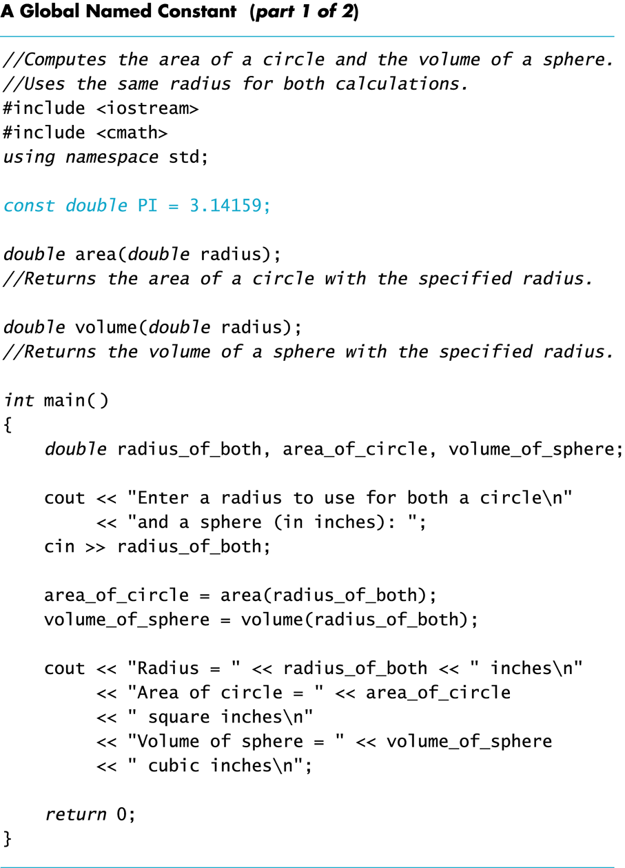
Display 4.12 (1/2)
Back
Next

Slide 89
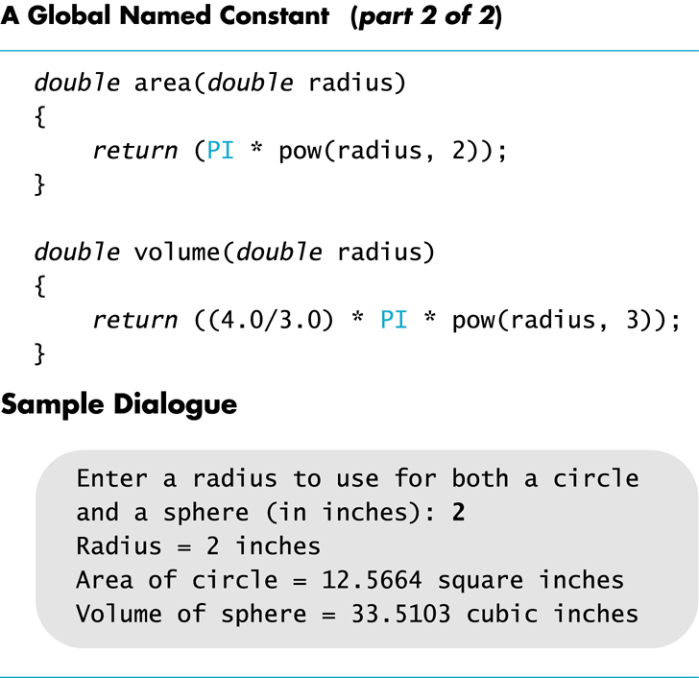
Display 4.12 (2/2)
Back
Next

Slide 90
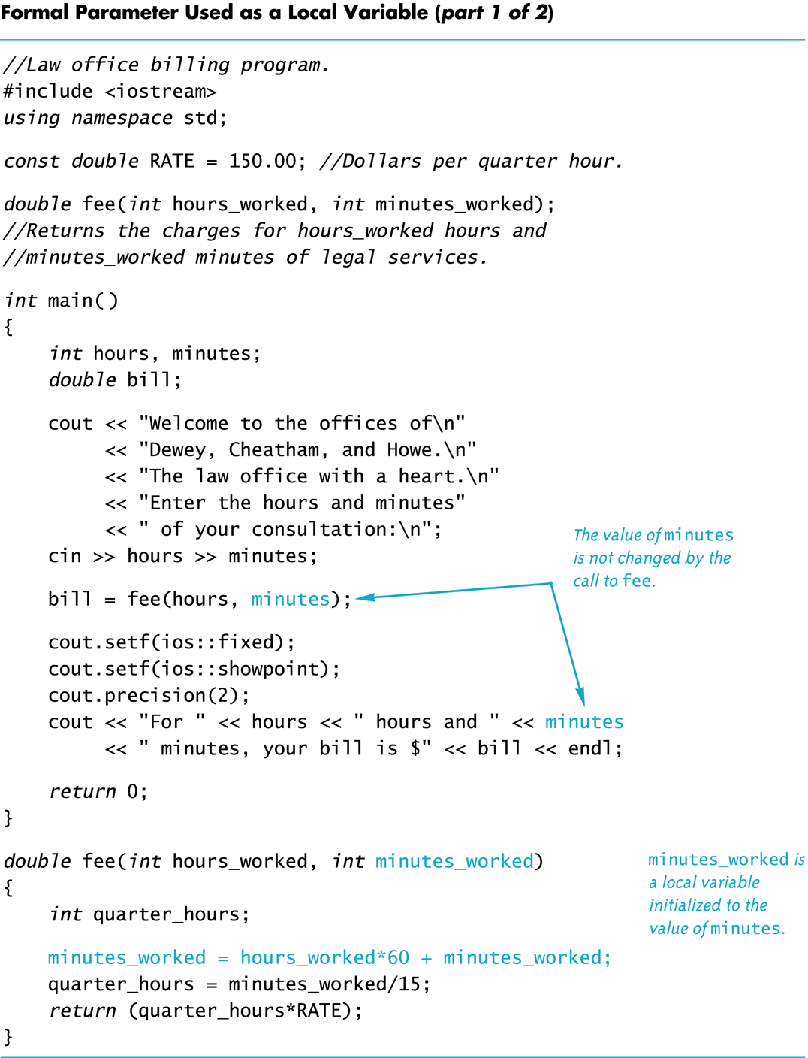
Display 4.13 (1/2)
Back
Next

Slide 91
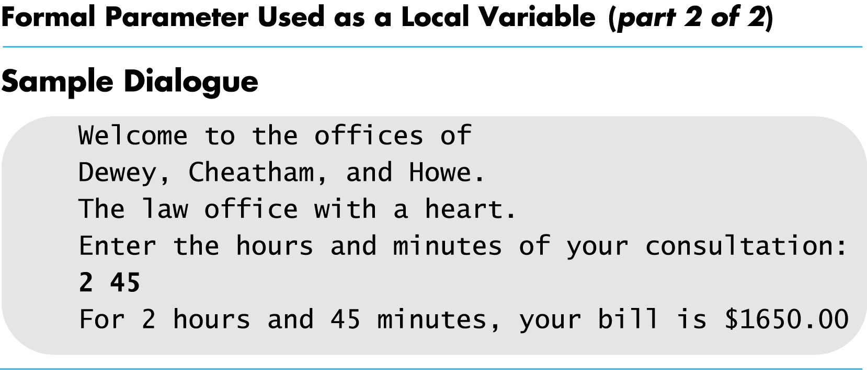
Display 4.13 (2/2)
Back
Next

Slide 92
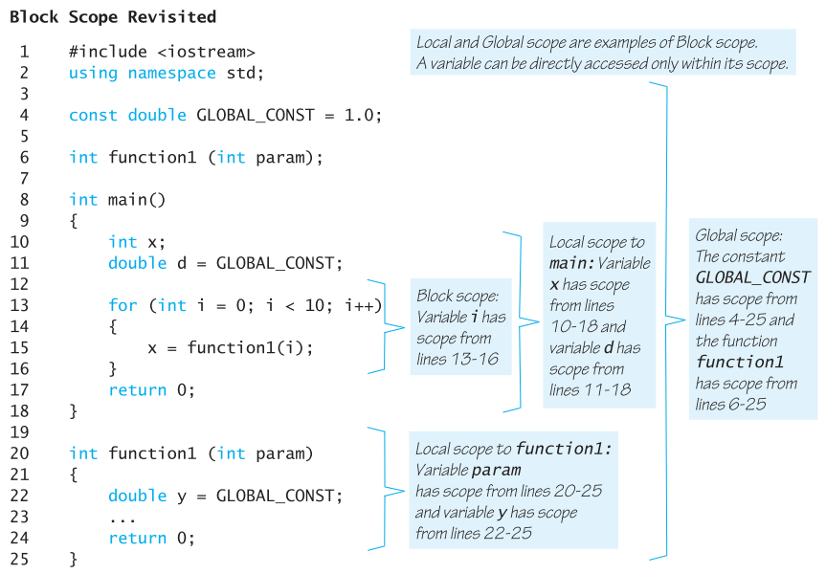
Display 4.14
Back
Next

Slide 93
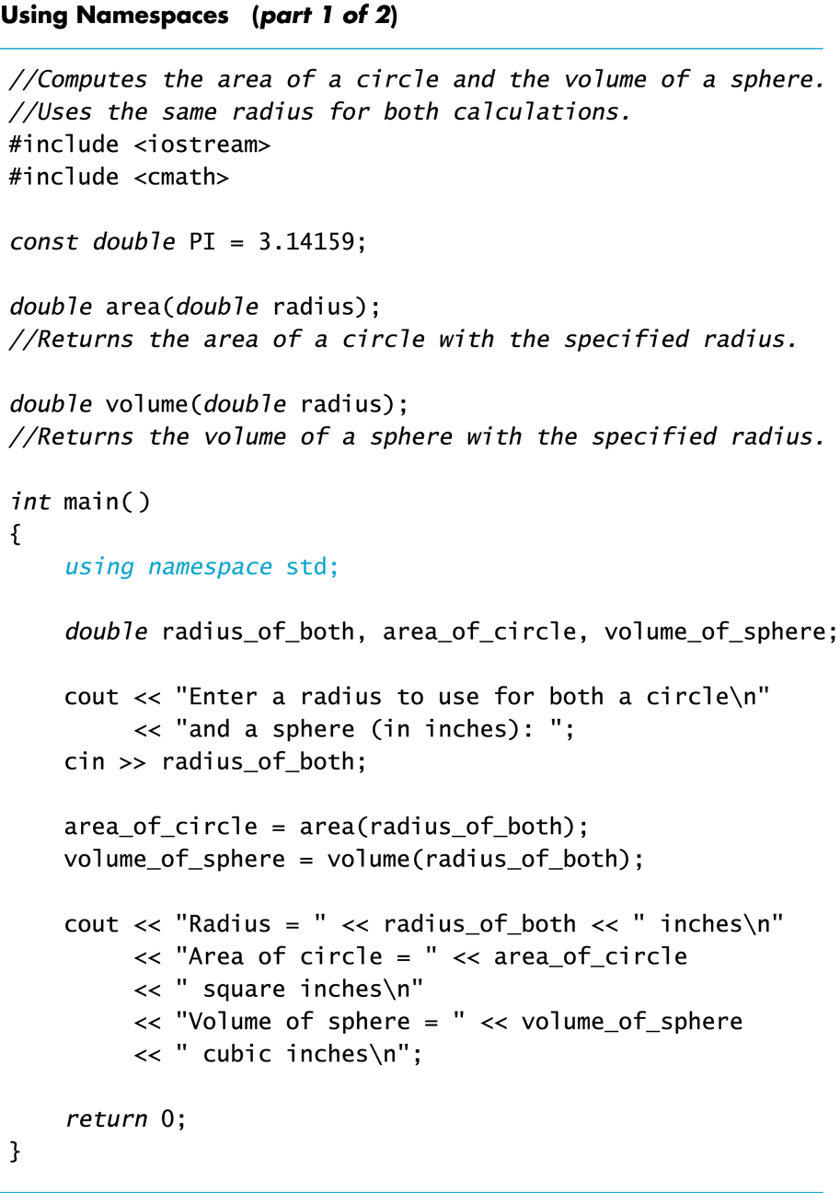
Display 4.15 (1/2)
Back
Next

Slide 94
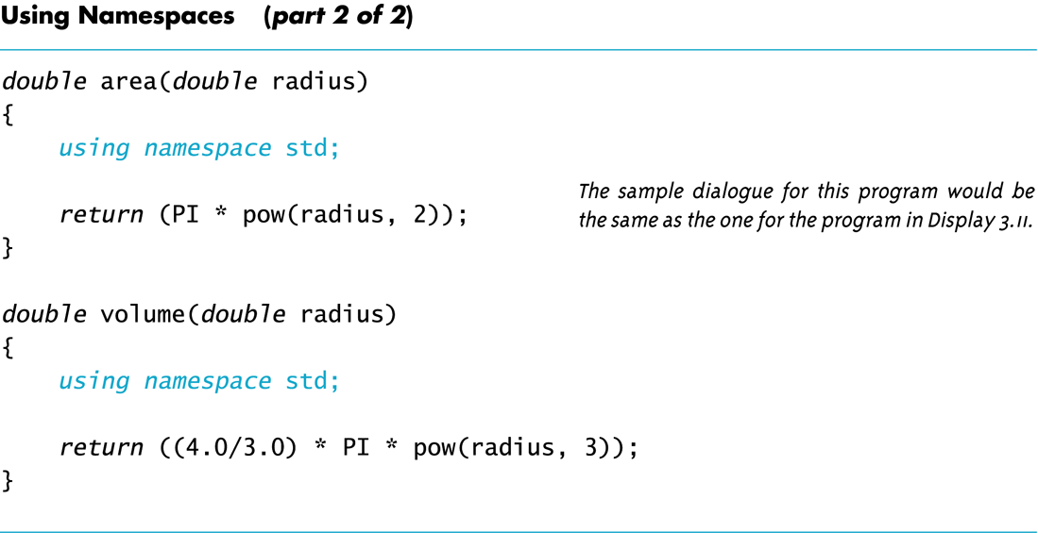
Display 4.15 (2/2)
Back
Next

Slide 95
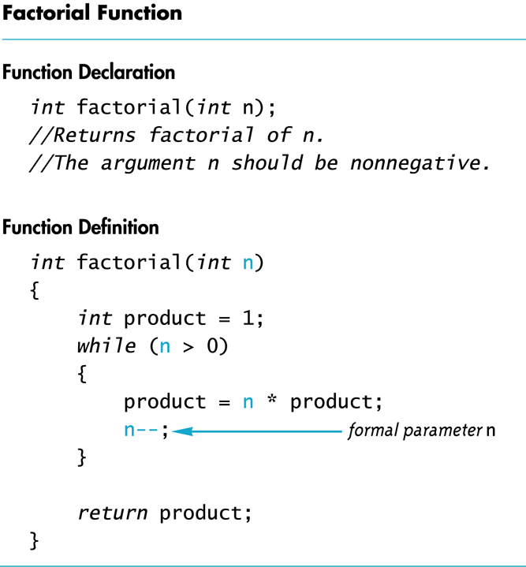
Display 4.16
Back
Next

Slide 96
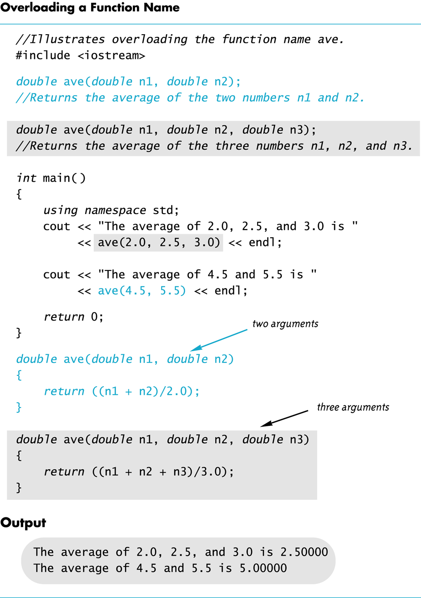
Display 4.17
Back
Next

Slide 97
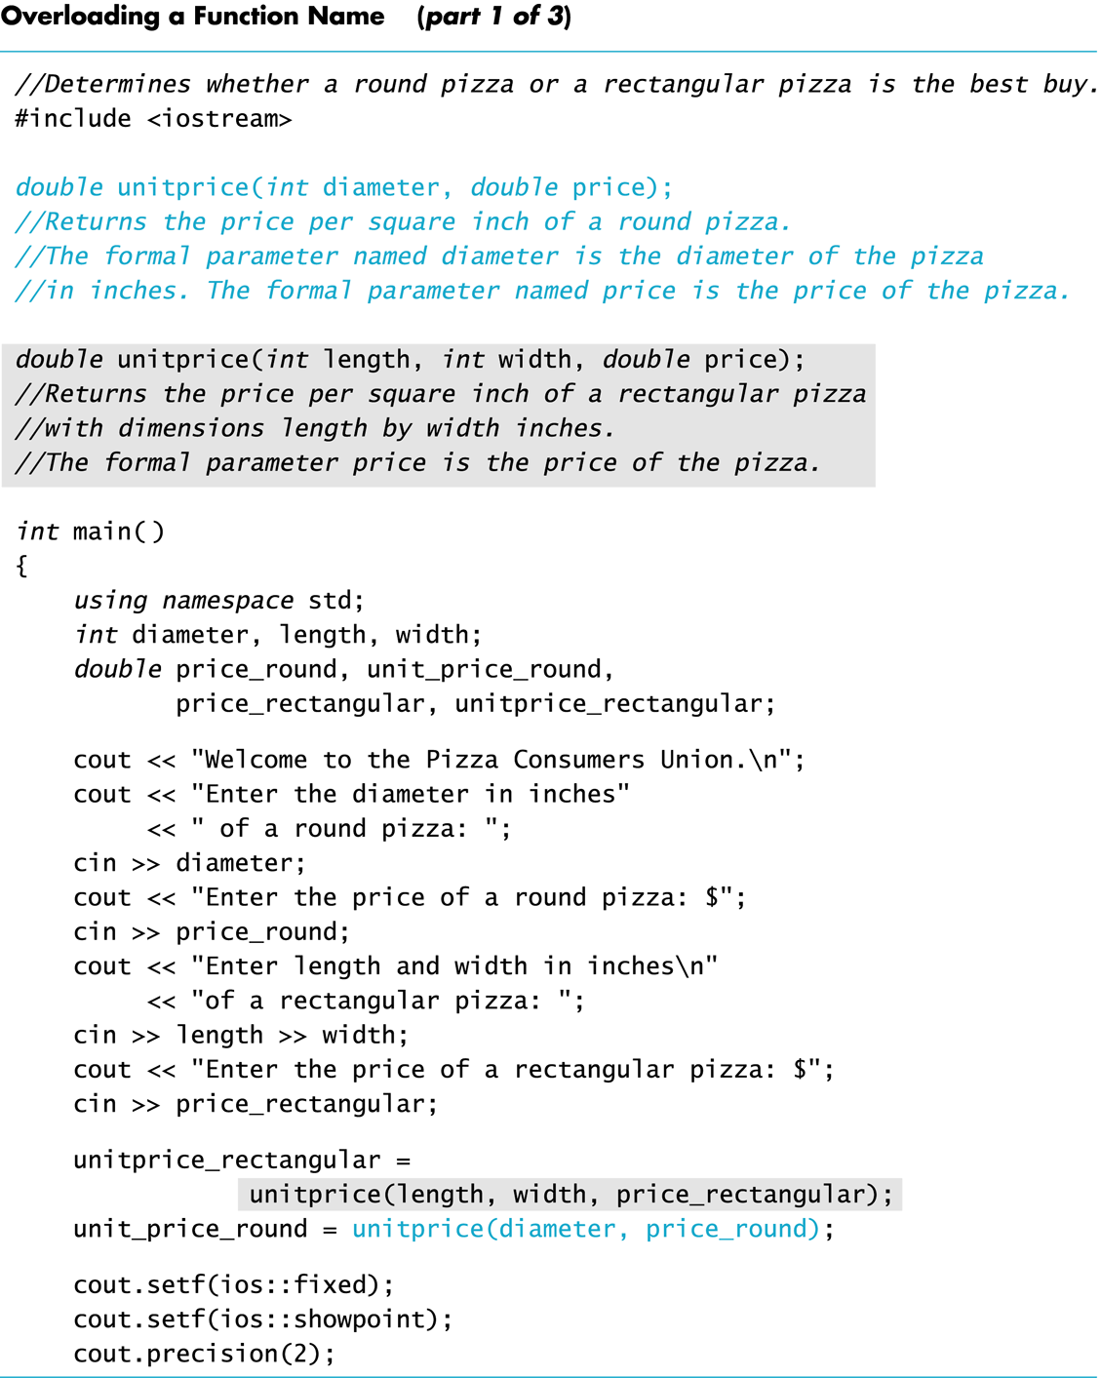
Display 4.18 (1/3)
Back
Next

Slide 98
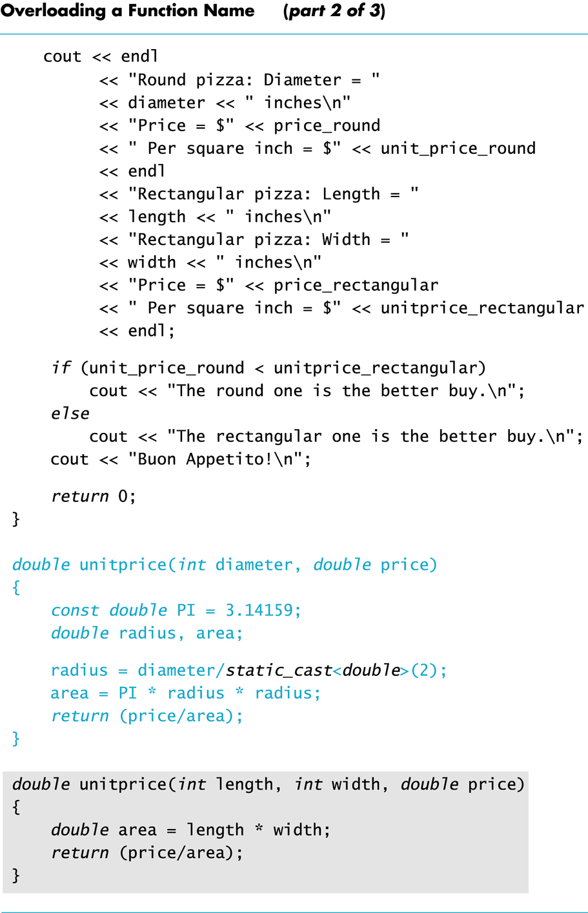
Display 4.18 (2/3)
Back
Next

Slide 99
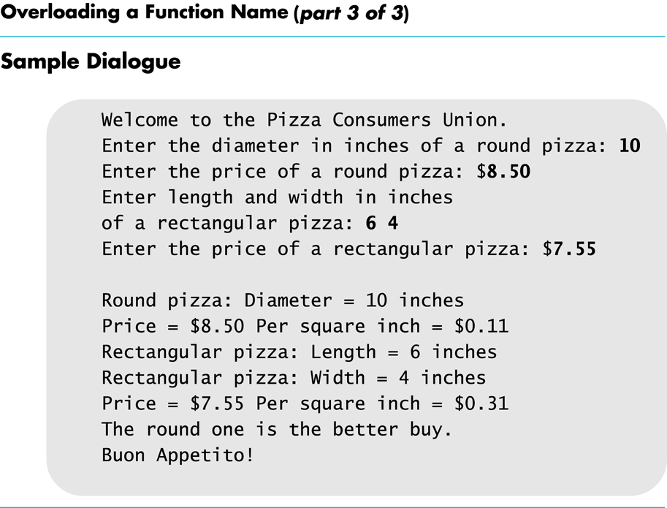
Display 4.18 (3/3)
Back
Next

